Slide 1

PPP Loans Data Analysis
Joun Bae
April 2021

Slide 2
Table of Contents
Research Background and Goals
Data Overview and Wrangling
Data Analysis and Insights
Hypothesis Testing
Wrap up and Recommendations

Slide 3
1. Research Background and Goals

Slide 4
Why PPP Loans?
Paycheck Protection Program (PPP) Loans have been critical for small businesses during COVID-19 Pandemic.
As of March 3rd, 7 million loans, equating to 680 billion dollars have been given out.
Controversy around logistics (e.g. large loan amounts going to bigger companies*)
In this study, approved PPP loan data will be analyzed to answer the questions:
What is the breakdown of loans by loan amount?
How much relief is going to support larger payroll costs vs. smaller?
Are there any differences in loan amounts based on reported gender?
The findings and recommendations can benefit government leaders to implement more equitable measures in future relief programs.
*https://www.chicagotribune.com/coronavirus/ct-coronavirus-potbelly-returns-ppp-loan-20200425-2usglsmb3ngujh2t7uk6dzxv5u-story.html)

Slide 5
2. Data Overview and Wrangling

Slide 6
Data Sourcing
The Small Business Administration has published PPP approved loan amounts by business and limited demographic information on sba.gov. Data as of March 3rd, 2021.
There are 9 csv files (total 3 GB of data and 7.3 million rows).
Files were uploaded as public AWS S3 objects and merged into one data frame using pandas.

Slide 7
Data Clean Up and Definitions
Data Clean up
Remove unnecessary columns
Drop N/As
Drop rows that had an approved loan amount less than $1 or less than 1 “Job Reported”
After clean up, 7.1 million rows total
Data Definitions
Column | Data Type
LoanNumber | Categorical / Discrete
CurrentApprovalAmount | Quantitative / Continuous
JobsReported | Quantitative / Discrete
Gender | Categorical / Nominal

Slide 8
3. Data Analysis and Insights

Slide 9
#1. What is the breakdown of loans by loan amount?
Methodology:
Group CurrentApprovalAmount (i.e. loan amount) by following brackets:
$0-10k
$10-99k
$100-499k
$500-999k
>$1M
Use matplotlib pyplot pie function to create pie chart visualization

Slide 10
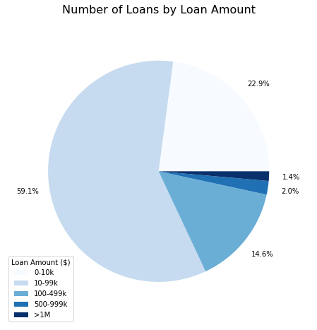
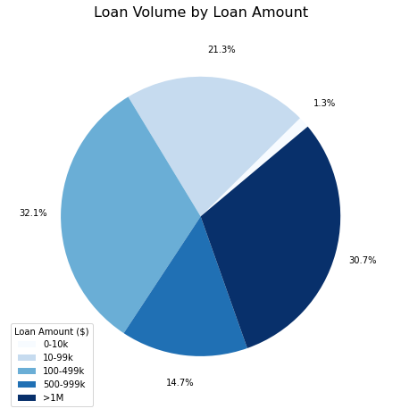
Only 1.4% of loans were greater than $1M USD, however they made up 30.7% of total loan amount.

Slide 11
#2. How much relief is going to larger payroll costs vs. smaller?
Context:
Business owners should calculate PPP loan amount as 2.5 months of payroll cost. Payroll includes wages, health insurance, 401k, etc*
The max wage amount per employee should be capped at $100k annualized*
We can look at annualized payroll per loan to see how much relief is going to larger payroll costs vs. smaller
*Source: https://www.sba.gov/sites/default/files/2021-03/HowtoCalculateFirstDrawLoanAmountsFAQs-3.12.21-508.pdf
Methodology:
Normalize payroll per loan by following equation:
(CurrentApprovalAmount / 2.5 x 12) / JobsReported = Annualized Avg Payroll
This will show how much relief was spent per job.
Group by following brackets:
0-39k
40-79k
80-99k
>100k
Use matplotlib pyplot pie function to create pie chart visualization

Slide 12
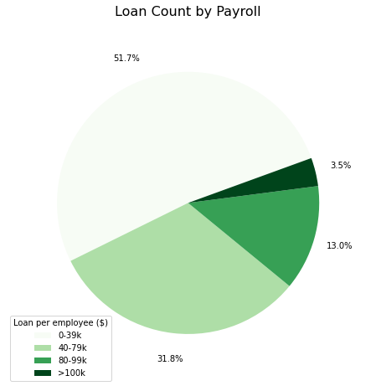
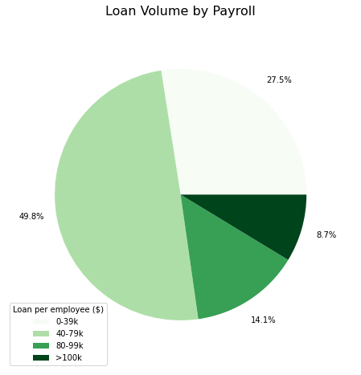
9% of dollars went to businesses where annualized payroll per employee was +$100k

Slide 13
17.4k loans, or 5.1B dollars were given to companies with annualized avg payroll >$200k
Annualized Payroll per Employee ($) | # of Loans | Loan Volume ($)
0-100k | 6,864,645 | 610 B
100-200k | 231,188 | 52 B
200-500k | 15,404 | 3.8 B
>500k | 2,109 | 1.3 B

Slide 14
4. Hypothesis Testing

Slide 15
#1. Are there differences in mean loan amount by Gender?
Null Hypothesis (H0: µ1 =µ2)
The mean loan amount is equal for male owned businesses vs. female owned businesses
Alternative Hypothesis (H1: µ1 ≠ µ2)
The mean loan amount is not equal for male owned businesses vs. female owned businesses

Slide 16
Methodology
Step 1: Gather gender values available for testing:
Gender Column | # of Loans
Unanswered | 4,826,524
Male Owned | 1,652,269
Female Owned | 634,552
Note: Majority (68%) of applicants did not disclose gender, potentially leading to skewed results. E.g. One gender could be more or less likely to disclose their gender

Slide 17
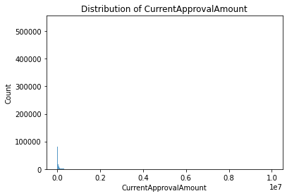
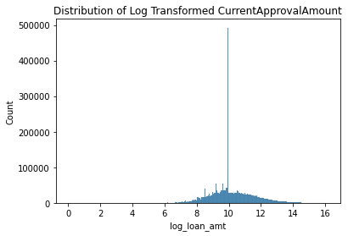
Methodology (cont’d)
Step 2: Analyze distribution of dependent variable (i.e CurrentApprovalAmount)
Finding: Distribution of variable is not normal
Step 3: Use Log transformation to conform the data to normality*
*https://www.ncbi.nlm.nih.gov/pmc/articles/PMC4120293/#:~:text=The%20log%20transformation%20is%2C%20arguably,normal%20or%20near%20normal%20distribution.

Slide 18
Methodology (cont’d)
Step 4: Create data frames for male owned and female owned businesses
Step 5: Perform independent samples T Tests on the log transformed loan amount and calculated confidence intervals
Step 6: Transform results back to original scale by taking anti log*
*Source: http://www.jerrydallal.com/LHSP/ci_logs.htm

Slide 19
Results and Interpretation
Result:
Reject the null hypothesis
At a p-value of <0.01, the median loan amount for males is approximately 1.547 of the loan amount for women (95% confidence level with CI of 1.541 to 1.553)
Potentially due to ratio of larger companies owned by men.
Technical Explanation of Interpretation*:
For log transformed data, typically data is transformed back to the original scale by taking the anti-log of the means. This results in the geometric mean, which is a good estimate of the median.
A property of the logarithm is that "the difference between logs is the log of the ratio".
Thus, when we take the anti log of the difference in mean log amounts, this translates to the "ratio of median of male loan amounts to female loan amounts.
*Source: http://www.jerrydallal.com/LHSP/ci_logs.htm

Slide 20
#2. Are there differences in mean loan amount by Gender after adjusting company size?
Null Hypothesis (H0: µ1 =µ2)
The mean loan amount is equal for male owned businesses that are small/medium/large vs. female owned businesses of the same size
Alternative Hypothesis (H1: µ1 ≠ µ2)
The mean loan amount is not equal for male owned businesses that are small/medium/large vs. female owned businesses of the same size

Slide 21
Methodology
Step 1: Group JobsReported by following brackets:
Large (100-500 employees)
Mid (10-99 employees)
Small (0-9 employees)
Step 2: Create dataframes for each bracket and gender
Step 3: Perform independent sample T Tests on the log transformed loan amount and calculated confidence intervals
Step 4: Results were transformed back to original scale by taking anti log

Slide 22
Results
At a p-value of <0.01, the median loan amount for male owners of large companies is approximately 1.298 of women (95% confidence level with CI of 1.256 to 1.341)
At a p-value of <0.01, the median loan amount for male owners of mid-size companies is approximately 1.502 of women (95% confidence level with CI of 1.207 to 1.869)
At a p-value of <0.01, the median loan amount for male owners of small companies is approximately 1.311 of women (95% confidence level with CI of 1.306 to 1.315)
At every level of company size, the median loan amount for females is lower at a significant level
*Source: http://www.jerrydallal.com/LHSP/ci_logs.htm

Slide 23
#3. Are there differences in % of PPP loans to women vs. total US % of women owned businesses?
Per the American Express 2019 study, 37% of US firms were owned by women.
Null Hypothesis (H0: µ1 =µ2)
The % of PPP loans to female owned businesses is equal to the total % of businesses owned by women in the US
Alternative Hypothesis (H1: µ1 ≠ µ2)
The % of PPP loans to female owned businesses is not equal to the total % of businesses owned by women in the US
https://s1.q4cdn.com/692158879/files/doc_library/file/2019-state-of-women-owned-businesses-report.pdf

Slide 24
Methodology & Results
Methodology:
Step 1: Understand % of PPP loans that went to women owned businesses
Finding: 28% of loans went to women owned businesses
Note: Unanswered population was removed
Step 2: Perform one sample z test to determine statistical significance
Result:
Reject the null hypothesis. At a p-value of <0.01, the proportion of women who received a PPP loan is 28%, and significantly smaller than the proportion of women owned businesses in the US.

Slide 25
5. Wrap up and Recommendations

Slide 26
Summary of Findings
Only 1.4% of loans were greater than $1M USD, however they made up 30.7% of total loan dollars.
3.5% of loans went to businesses where annualized payroll per employee was +$100k, even though the current PPP loan application guidance is to cap wages up to 100k.
17.5k loans went to companies with payroll costs >$200k, equating to $5.1B
The median loan amount for women owned businesses were significantly lower than male owned businesses, even when adjusting for company size*
Only 28% of loans went to women owned businesses, when 37% of US firms are owned by women.*

Slide 27
Recommendations
In order to optimize the reach of relief, implement measures to monitor and enforce loan cap of $100k per employee
For all loans that had >$200k payroll per employee, audit loans to determine misuse of funds, or data issues.
Potential outreach and education for women owned businesses on future relief programs
Further analysis on potential drivers for lower loan amount for women owned businesses vs. male counterparts

